Slide 1

Introduction to TBIL
TBIL Community

Slide 2

This material is based upon work supported by the National Science Foundation under Award #2011807. Any opinions, findings and conclusions or recommendations expressed in this material are those of the author(s) and do not necessarily reflect the views of the National Science Foundation.

Slide 3
Learning Objectives
Be able to describe the basic structure of a TBIL class and 4-S activities
Be able to articulate how TBIL supports the four pillars of IBL
Be able to compare and contrast the three types of TBIL activities

Slide 4
Preparation Materials
“Introduction to Team-Based Learning” by Sibley and Spirodonoff
“Team-Based Inquiry Learning” by Lewis, Clontz, and Estis

Slide 5


Slide 6
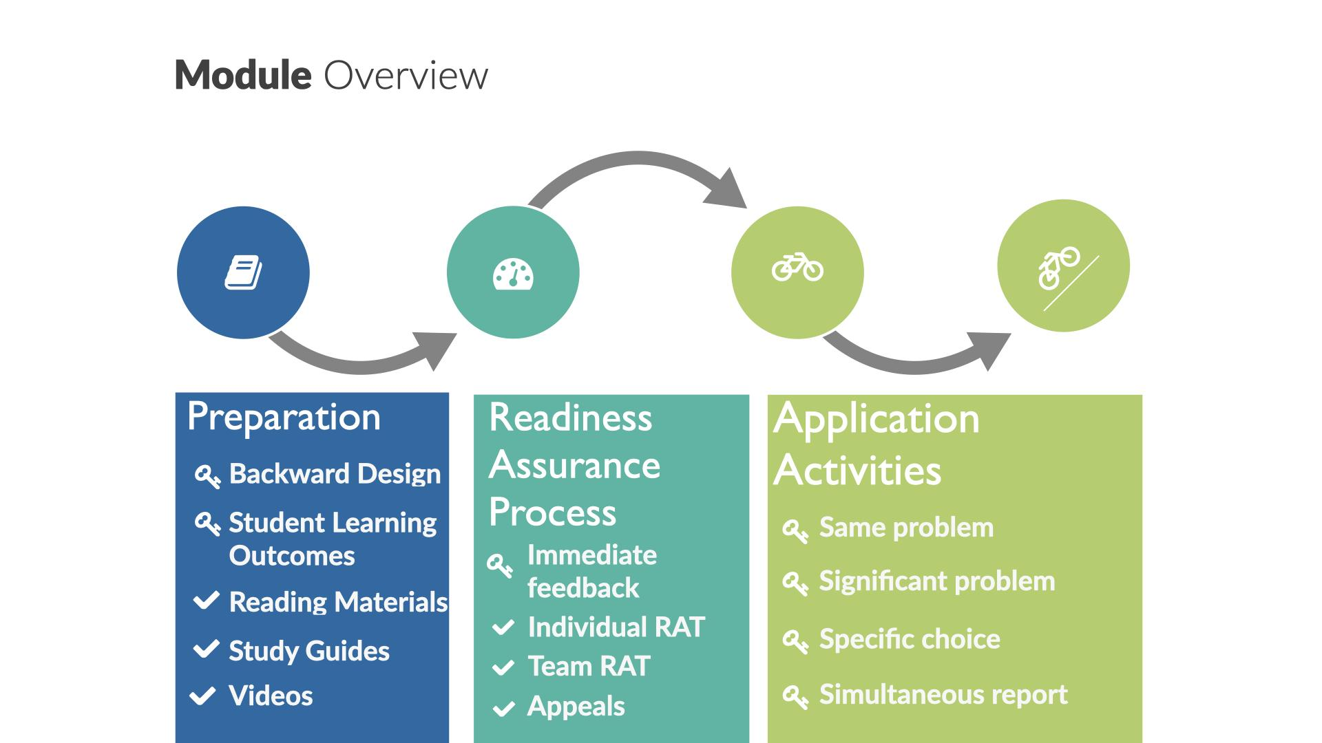

Slide 7


Slide 8
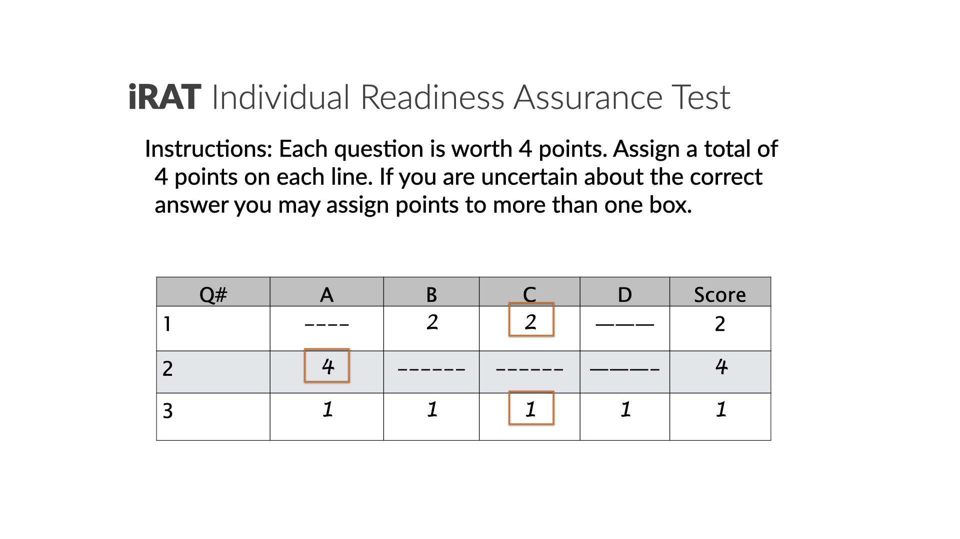

Slide 9


Slide 10
Lets get in teams!
Add instructions on how to split up into teams

Slide 11
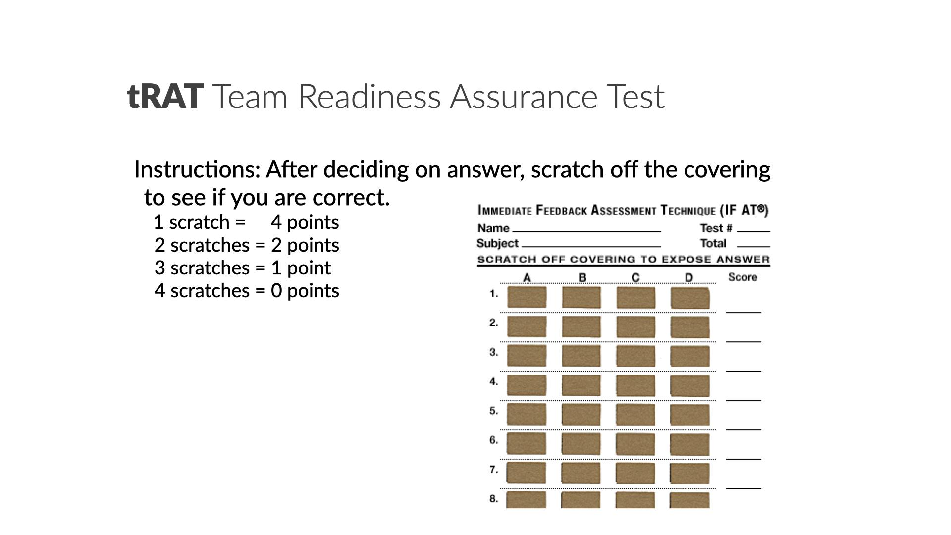

Slide 12
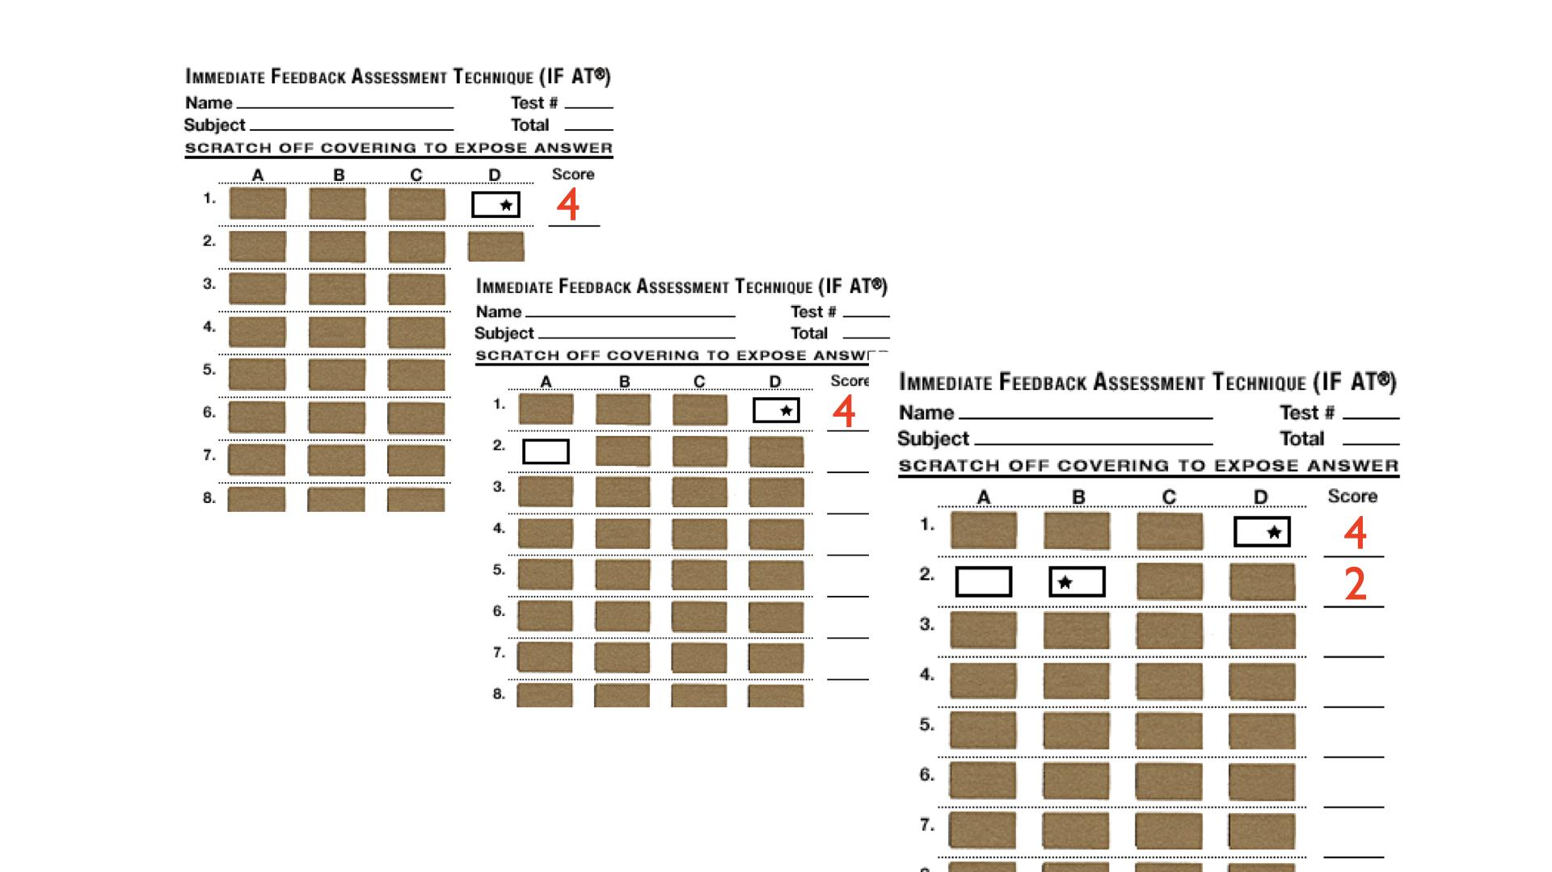

Slide 13
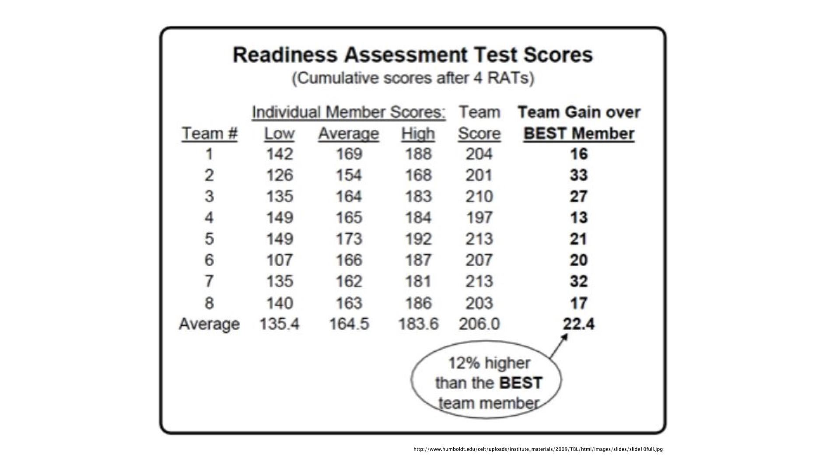

Slide 14
Won’t students just vote on the answer?
In our study, tRAT scores were 9.7% higher than a voting strategy would produce
This is matched by our classroom observations

Slide 15
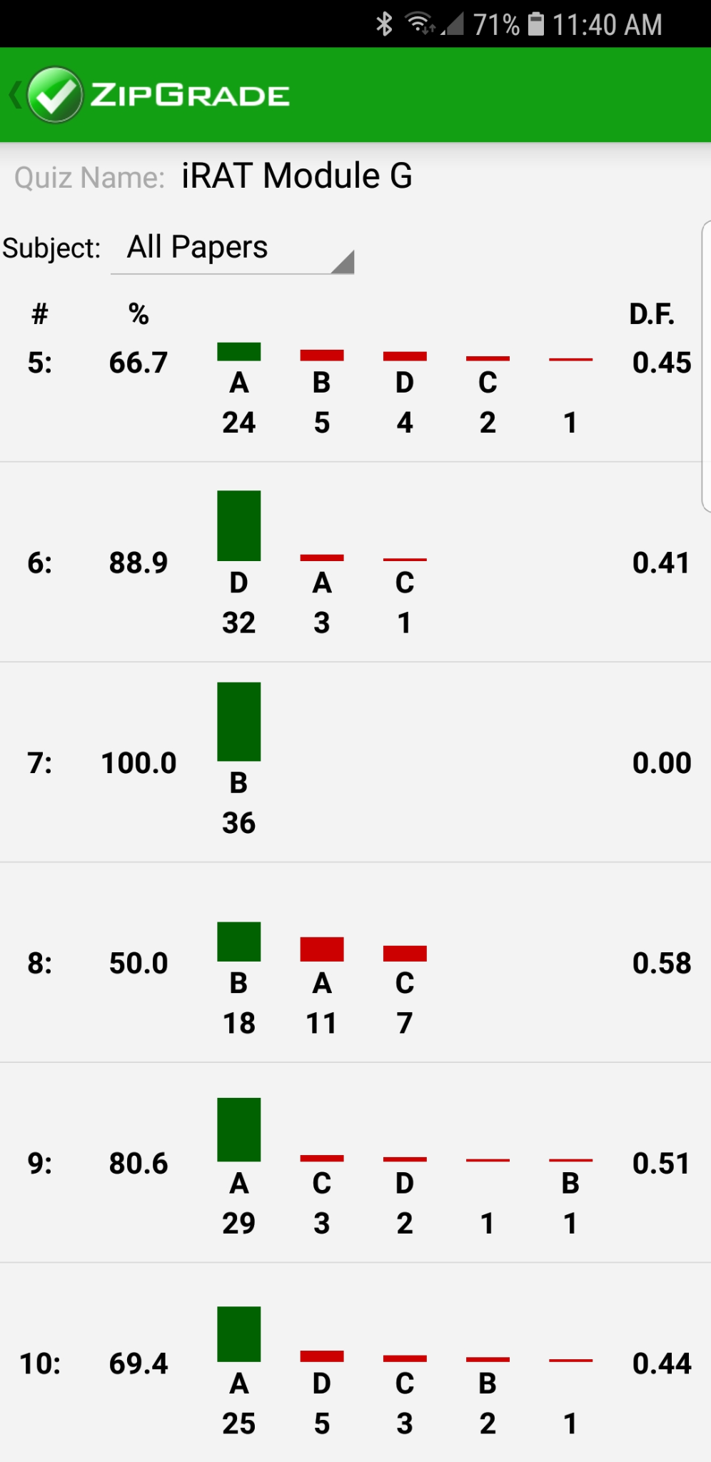
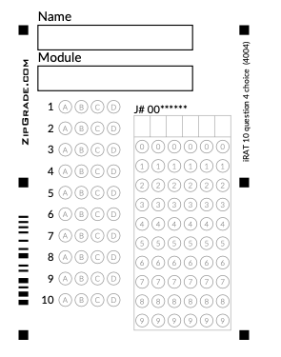
Just-in-Time Teaching

Slide 16
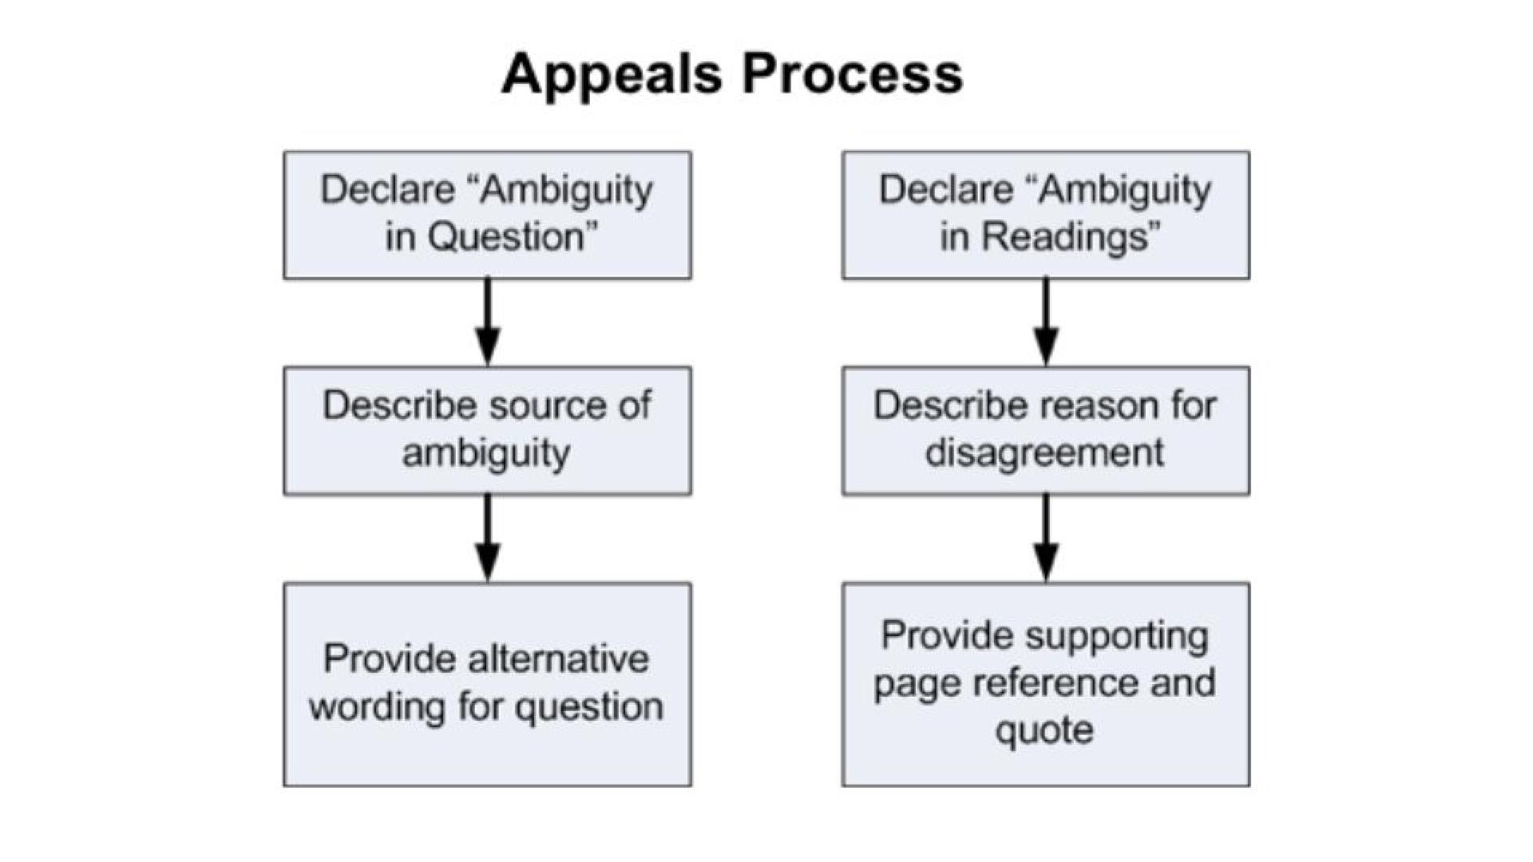


Slide 17
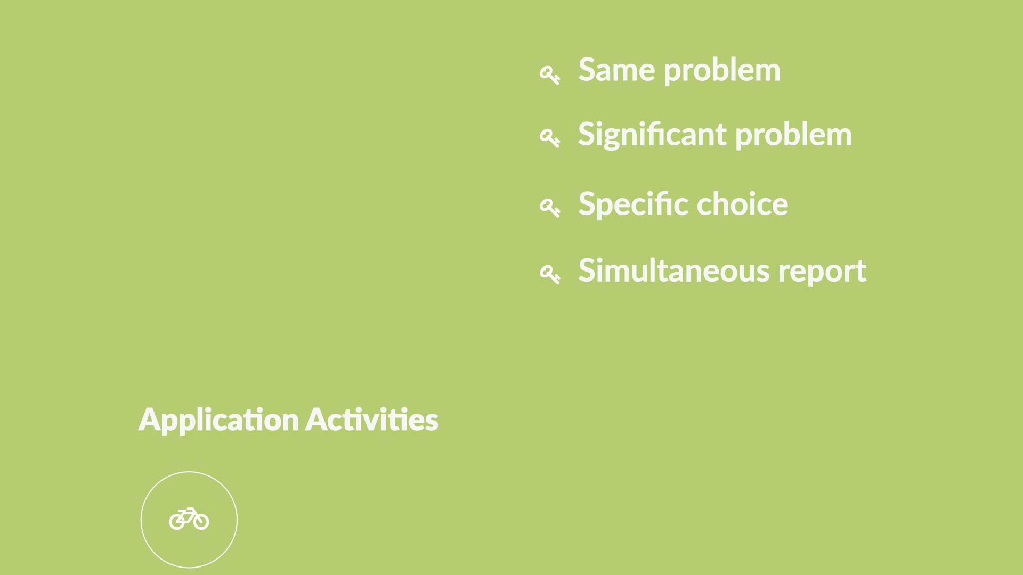

Slide 18
Activity 1: In your experience teaching students in groups, or as a member of a group yourself, identify the MOST DIFFICULT CHALLENGE.
Some members of the group did all of the work.
Sometimes a particular group member would dominate the group.
Group performance was negatively impacted by the limited contributions of one group member.
There were no difficult issues. Group members always contribute equally.

Slide 19
Activity 2: Which aspect of TBL that BEST addresses issues with group work?
Individuals are held accountable through the iRATs and individual grades.
Students rate their teammates leading to a Team Contribution component of the final course grade.
Application activities are conducted in-class with no group work assigned outside of class.
The 4S approach to application activities eliminates a “divide and conquer” approach.

Slide 20
Activity 3: You will be teaching a Calculus I class via TBIL.
Which of the following factors is it MOST appropriate to consider when creating your TBIL teams?
Students’ majors
Students’ years in school
Students’ score on a pre-test of their knowledge
Students’ math anxiety
Students’ confidence in math

Slide 21
Activity 4: An instructor new to TBL decides to save time by omitting the tRAT portion of TBL. How will this action most likely impact learning?
Decreased individual preparation, since less time is spent assessing content mastery.
Decreased individual preparation, since there is less accountability to teammates.
Decreased content mastery, as students are less ready to engage with the 4-S activities.
Improved higher learning skills, since there is more time available for application exercises.
Improved team cohesiveness, since there is less opportunity for team dissension.

Slide 22
Activity 5: From an instructional perspective, which of the following is the MOST important benefit of TBL?
Enhanced session attendance
Increased competence solving problems
Development of better team-working skills
Increased learner engagement
Increased learner motivation

Slide 23
Team-Based Inquiry Learning
Team-
Based
Learning
Inquiry-
Based
Learning
TBIL

Slide 24

Inquiry-Based Learning
Four pillars:
Students engage deeply with coherent and meaningful mathematical tasks
Students collaboratively process mathematical ideas
Instructors inquire into student thinking
Instructors foster equity in their design and facilitation choices
Laursen & Rasmussen, 2019

Slide 25
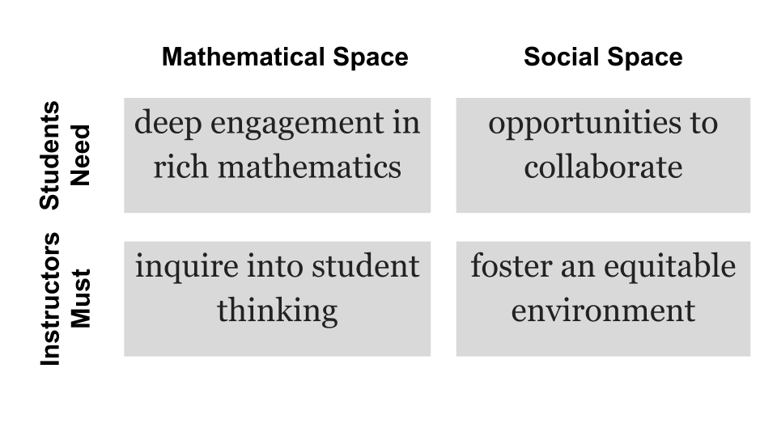
The 4 pillars in a diagram
Four pillars by Laursen & Rasmussen, 2019, diagram by Nina White

Slide 26
Students engage deeply with coherent and meaningful mathematical tasks
Students should work on significant problems (tasks)
Task sequences should be carefully scaffolded
Students should have space to explore
Requiring students to make a specific choice or solve a specific task can help them narrow their focus

Slide 27
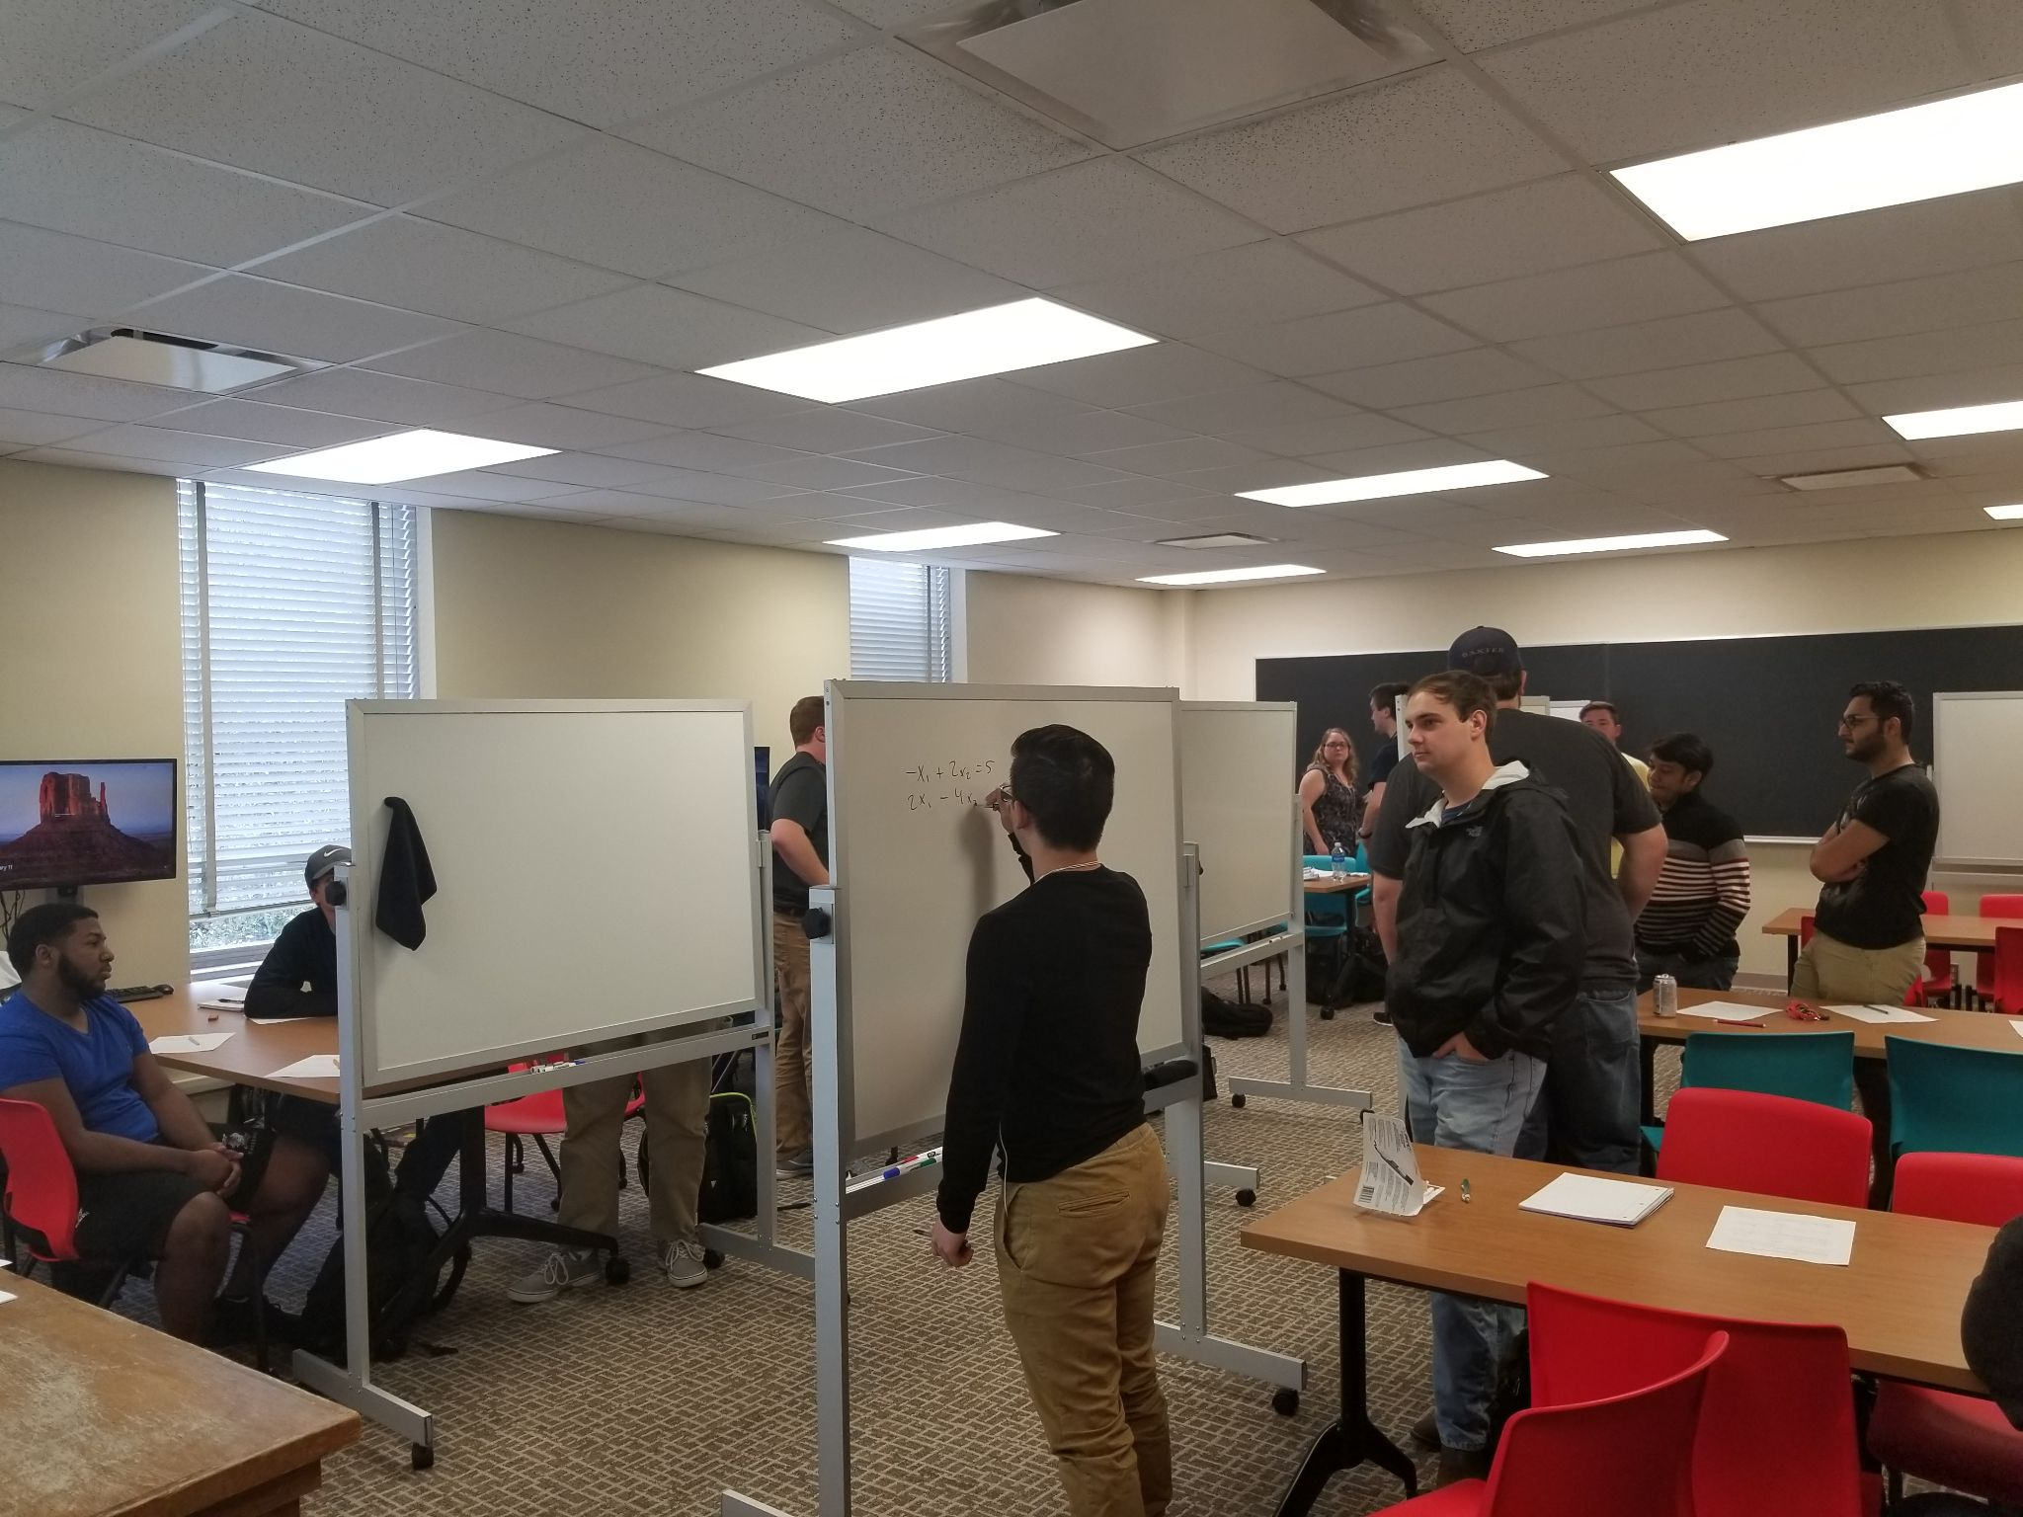
Students collaboratively process mathematical ideas
Teams should work on same problem
Shared workspace for each team (e.g. vertical whiteboard) is ideal
Notes:
Specific choice also forces students to collaborate

Slide 28
Instructors inquire into student thinking
4-S structure facilitates classwide discussions centering student thinking
Simultaneous reporting can be used to set up a tension of ideas that is resolved through the classwide discussion
Comparing and contrasting multiple approaches to the same problem can develop students’ flexibility in problem solving
Instructors move through classroom as teams work at their problem
Notes:
Shared vertical space also helps inquire into the student thinking

Slide 29
Instructors foster equity in their design and facilitation choices
TBIL is not a magic bullet to make your class more equitable
Research so far has found IBL can be more equitable, but may not be inherently
None of the features of TBL will automatically make an IBL class more equitable either
When making choices, look past “Does this help students?” to “Which students does this help?”
Notes:
Scaffolding can help make the discussion more equitable

Slide 30
Activity 6: Which strategy is best to ensure all students have the opportunity to share their thinking in whole class discussions?
Assign a student from each group to be the group reporter (rotating each class)
Tell teams that a member cannot report more than once each class
Privately invite quiet students to share particular ideas you overhear them say in their group
Share a quiet student’s thinking for them to the whole class

Slide 31
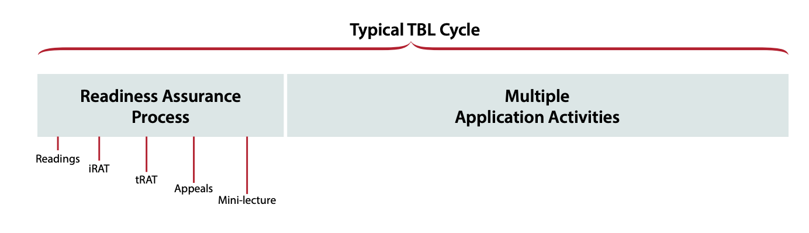
Readiness Assessment Process
Before working starting on the new content in a module, students are assigned readings/video/practice that address prerequisites. An individual and team test follows and instructor can administer just in time teaching on these concepts
Notes:
What is in a RAT? Example determinant as area of parallelogram… parallelogram?

Slide 32
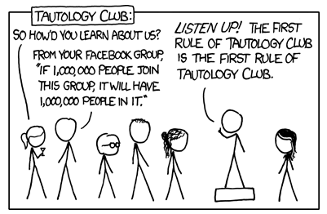
Readiness Assurance Process
The purpose of the readiness assurance process is to assure that students are ready for the application activities
xkcd.com/703

Slide 33
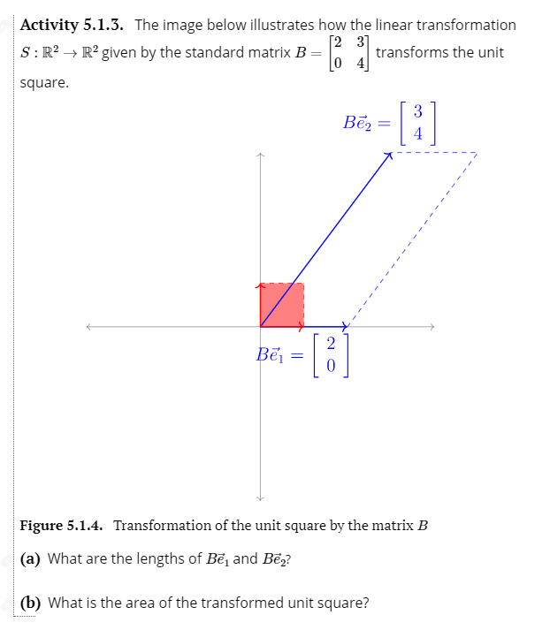
Readiness Assurance Process
Often students need to remind themselves of prerequisite knowledge from previous courses
When building on topics from earlier in the course, explicitly call this out

Slide 34
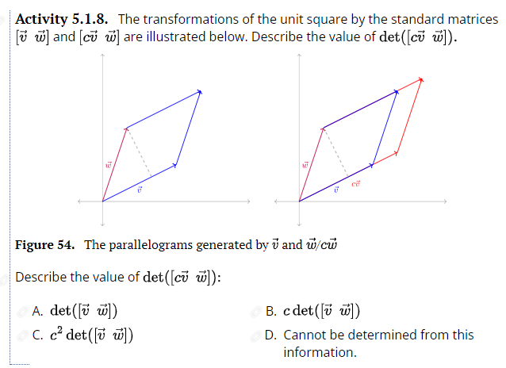
What prerequisite knowledge do students need to be able to answer this question?

Slide 35
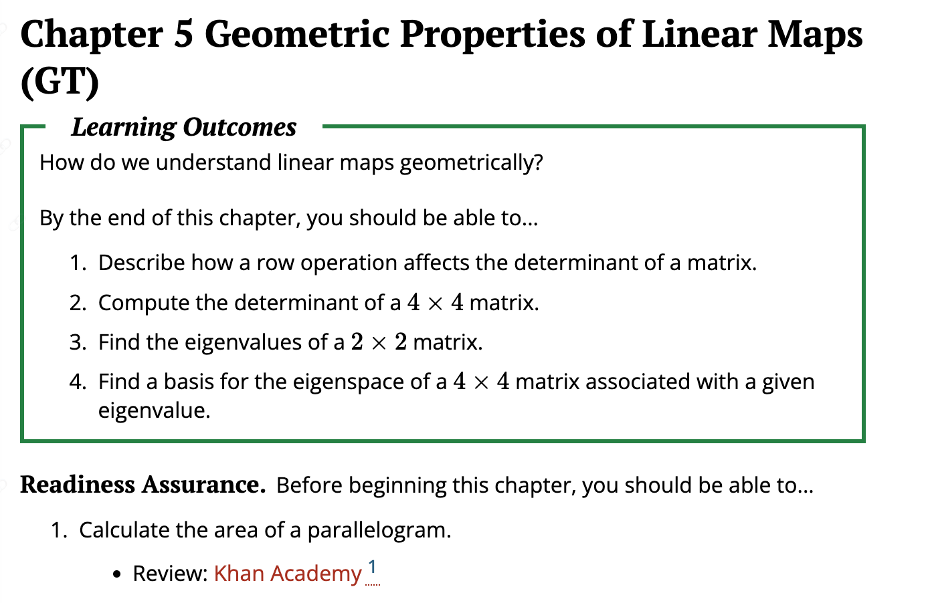
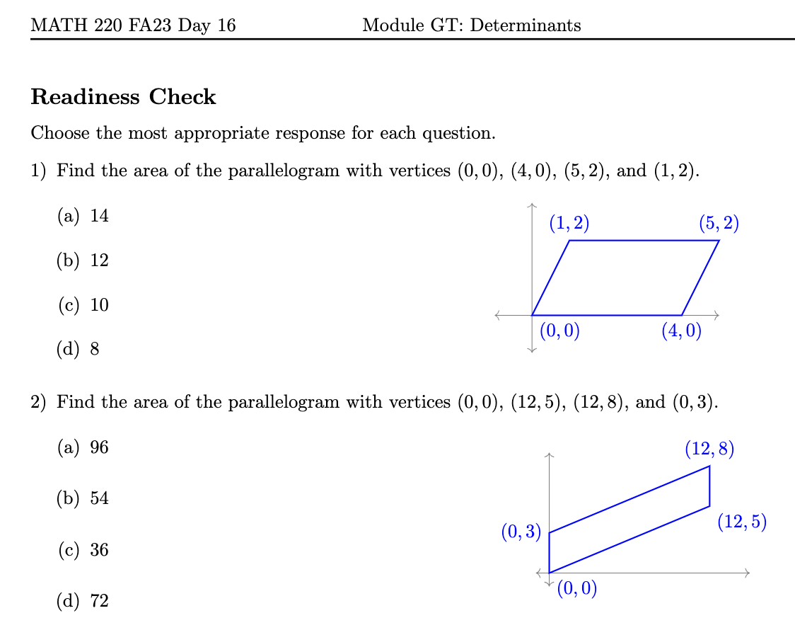
References…
…Test
Notes:
Once we have addressed just-in-time needed prereqs, we can move to the new content and fun activities! Let’s look at these a bit more

Slide 36
Types of TBIL 4-S Activities
Scaffolded Exploration and Discovery
Fluency Builders
Flexible Extension

Slide 37

Scaffolded Exploration & Discovery
Explore a new idea
Motivate a definition or a technique
Carefully scaffolded

Slide 38
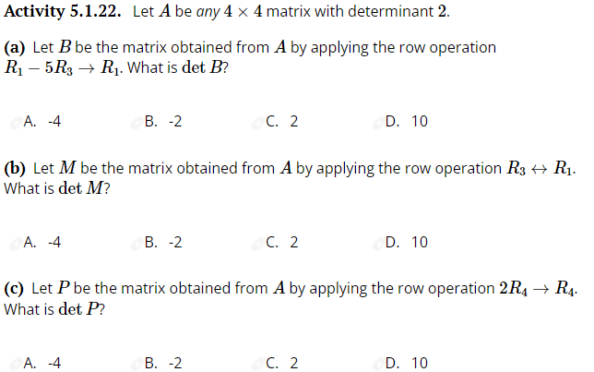
Fluency Builders
Build procedural fluency
Scaffolding (partly or completely) removed

Slide 39
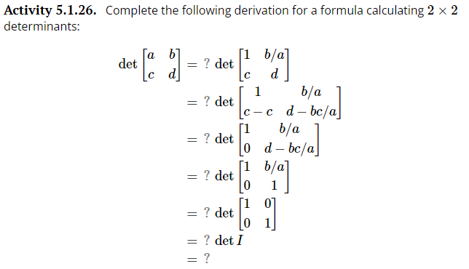
Flexible Extension
Apply existing knowledge to new context
Pushes student thinking forwards

Slide 40
Activity 7: Which type of TBIL class activity do you think is most essential for student learning?
Scaffolded Exploration
Fluency Builder
Flexible Extension
Notes:
Can be omitted for time.

Slide 41
In as few words as possible… TBIL features
TBL scaffolding + IBL inquiry
Application activities which foster class discussion
Readiness Assurance Process to ensure students are ready
Scaffolding for progression in cognitive demand

Slide 42
TBIL Resources
TBIL Resource Library: https://tbil.org
Activity books
Exercise banks
TBIL Community Slack

